Slide 1
Population | 2.0 Treatment | 4.5 Treatment | 7.0 Treatment | 9.0 Treatment
Konnevesi | 2.2 | 4.0 | 6.9 | 8.0
Superior | 2.0 | 4.4 | 6.9 | 8.9
Ontario | 2.0 | 4.4 | 6.9 | 8.9

Slide 2
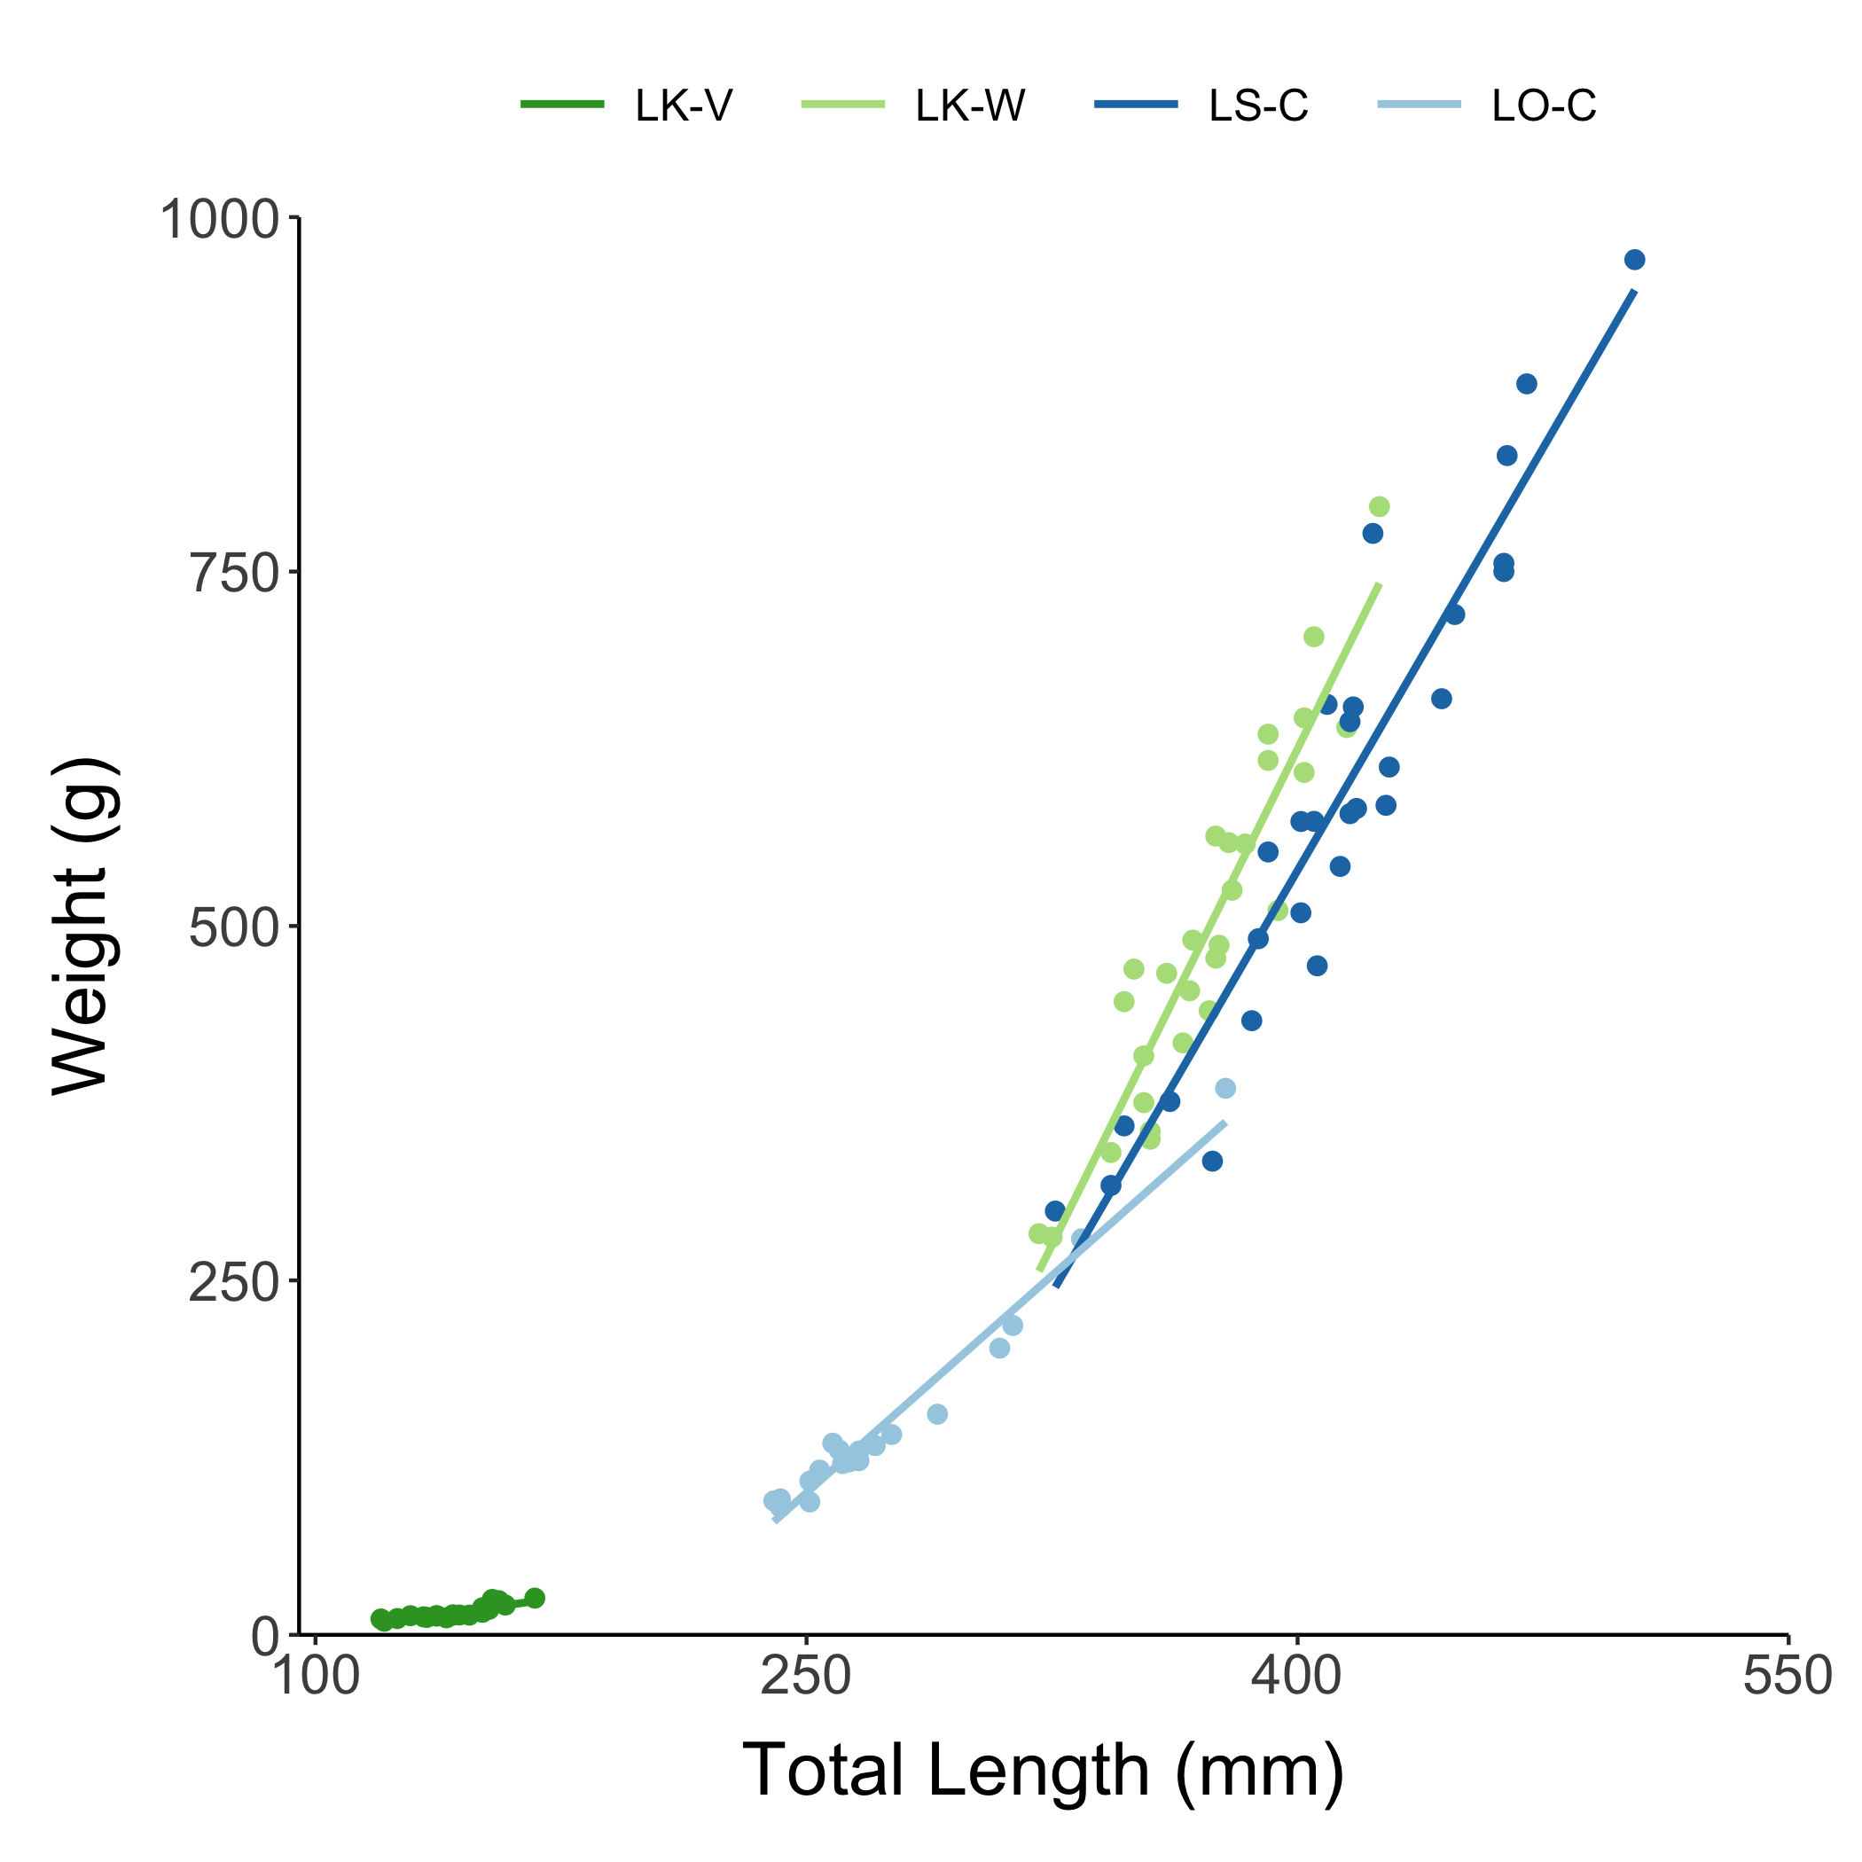
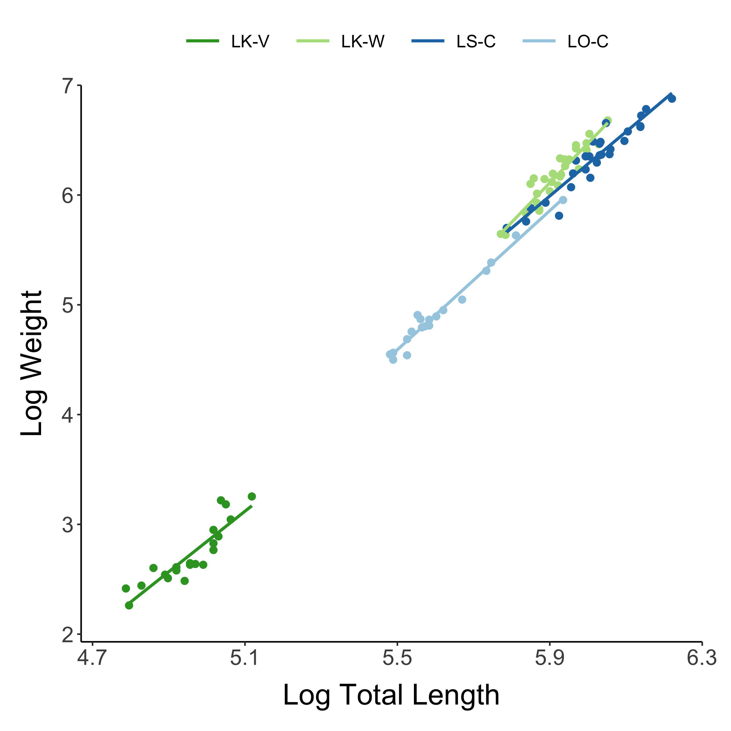

Slide 3
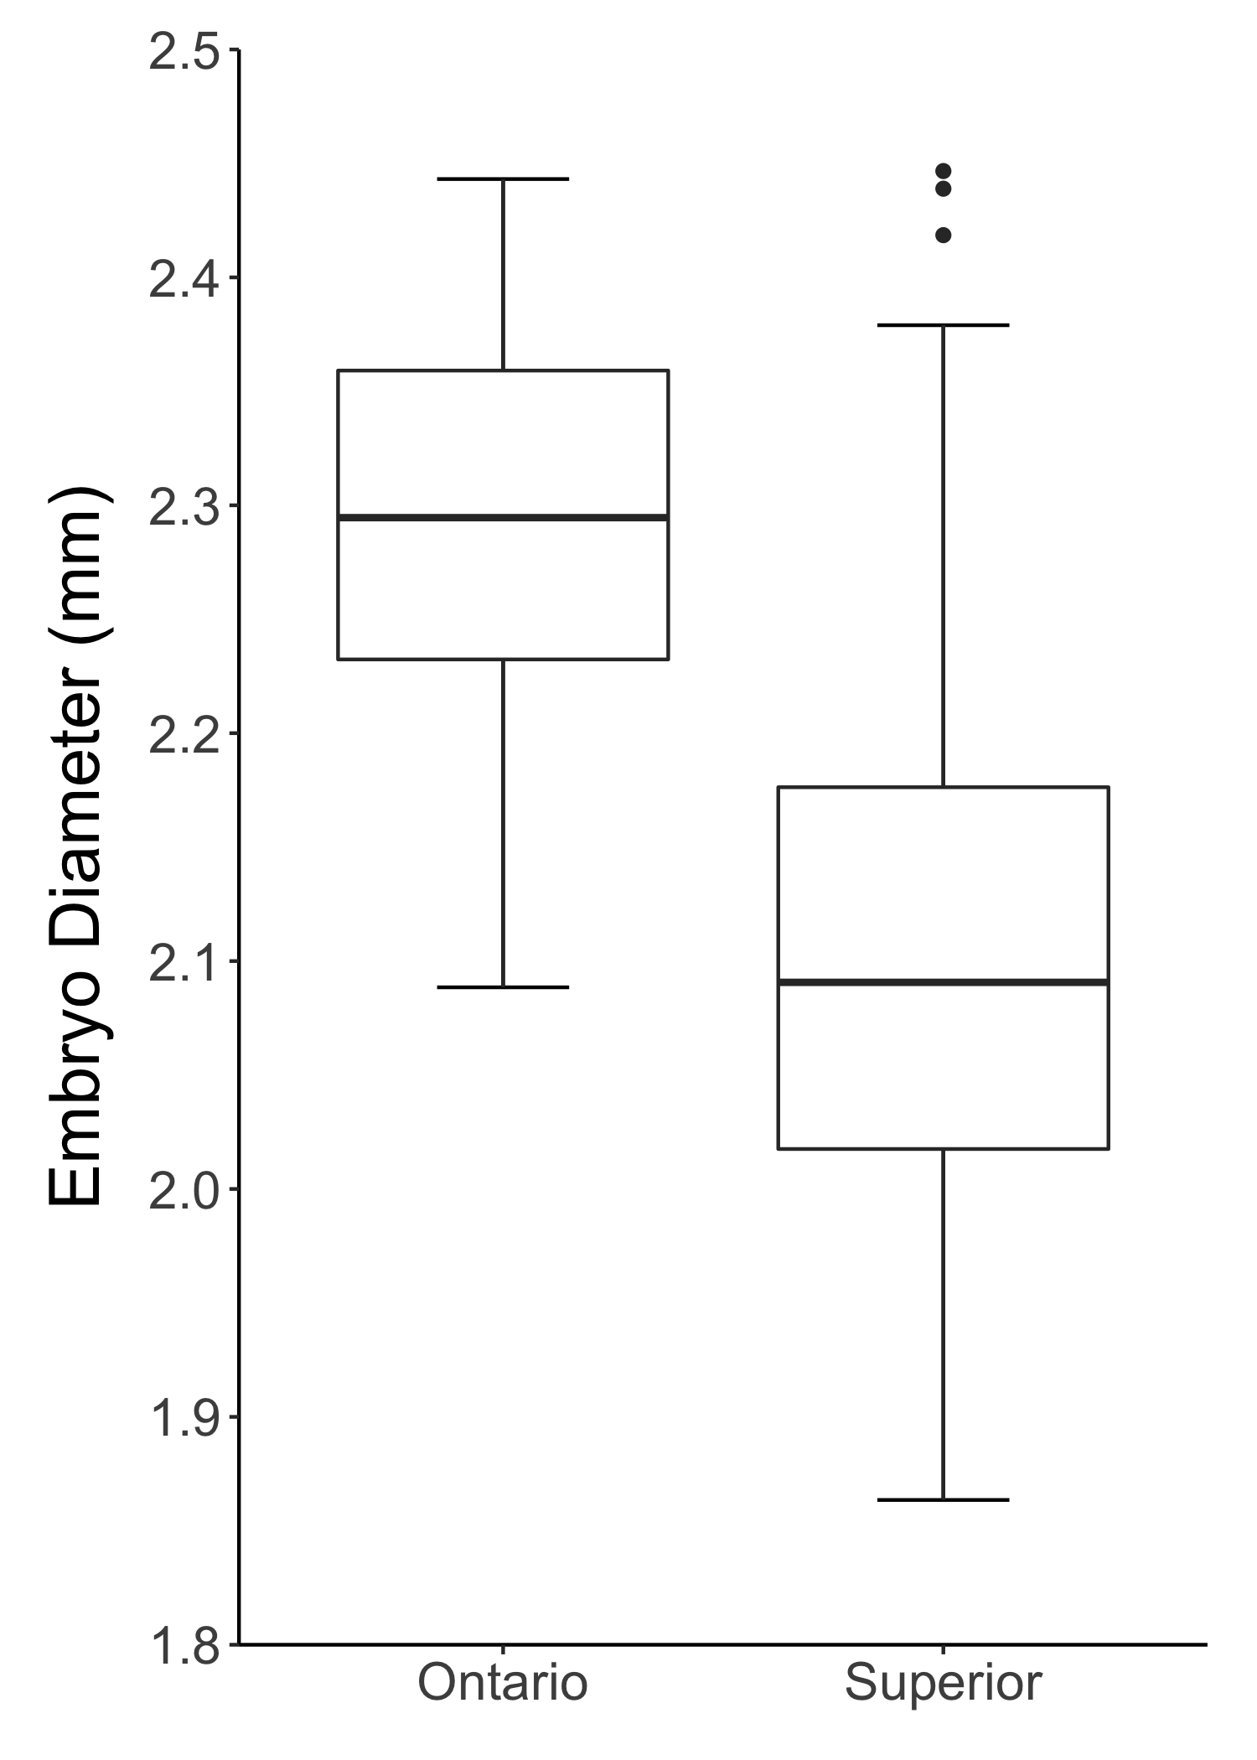

Slide 4
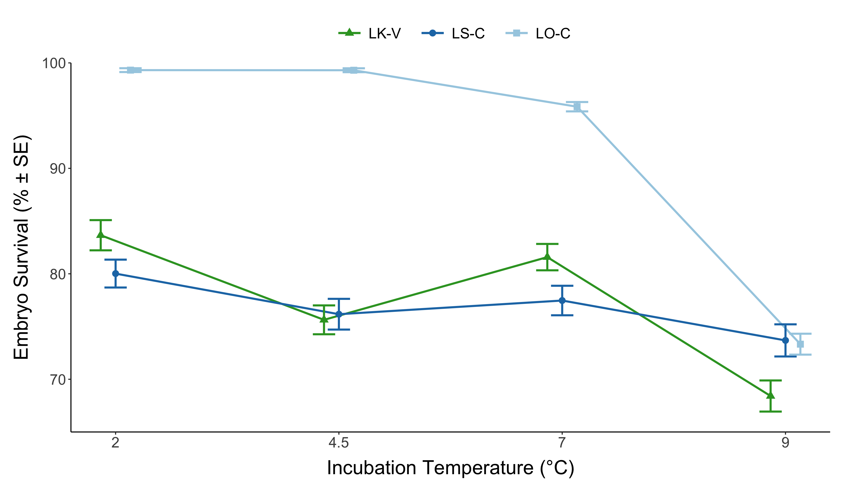

Slide 5
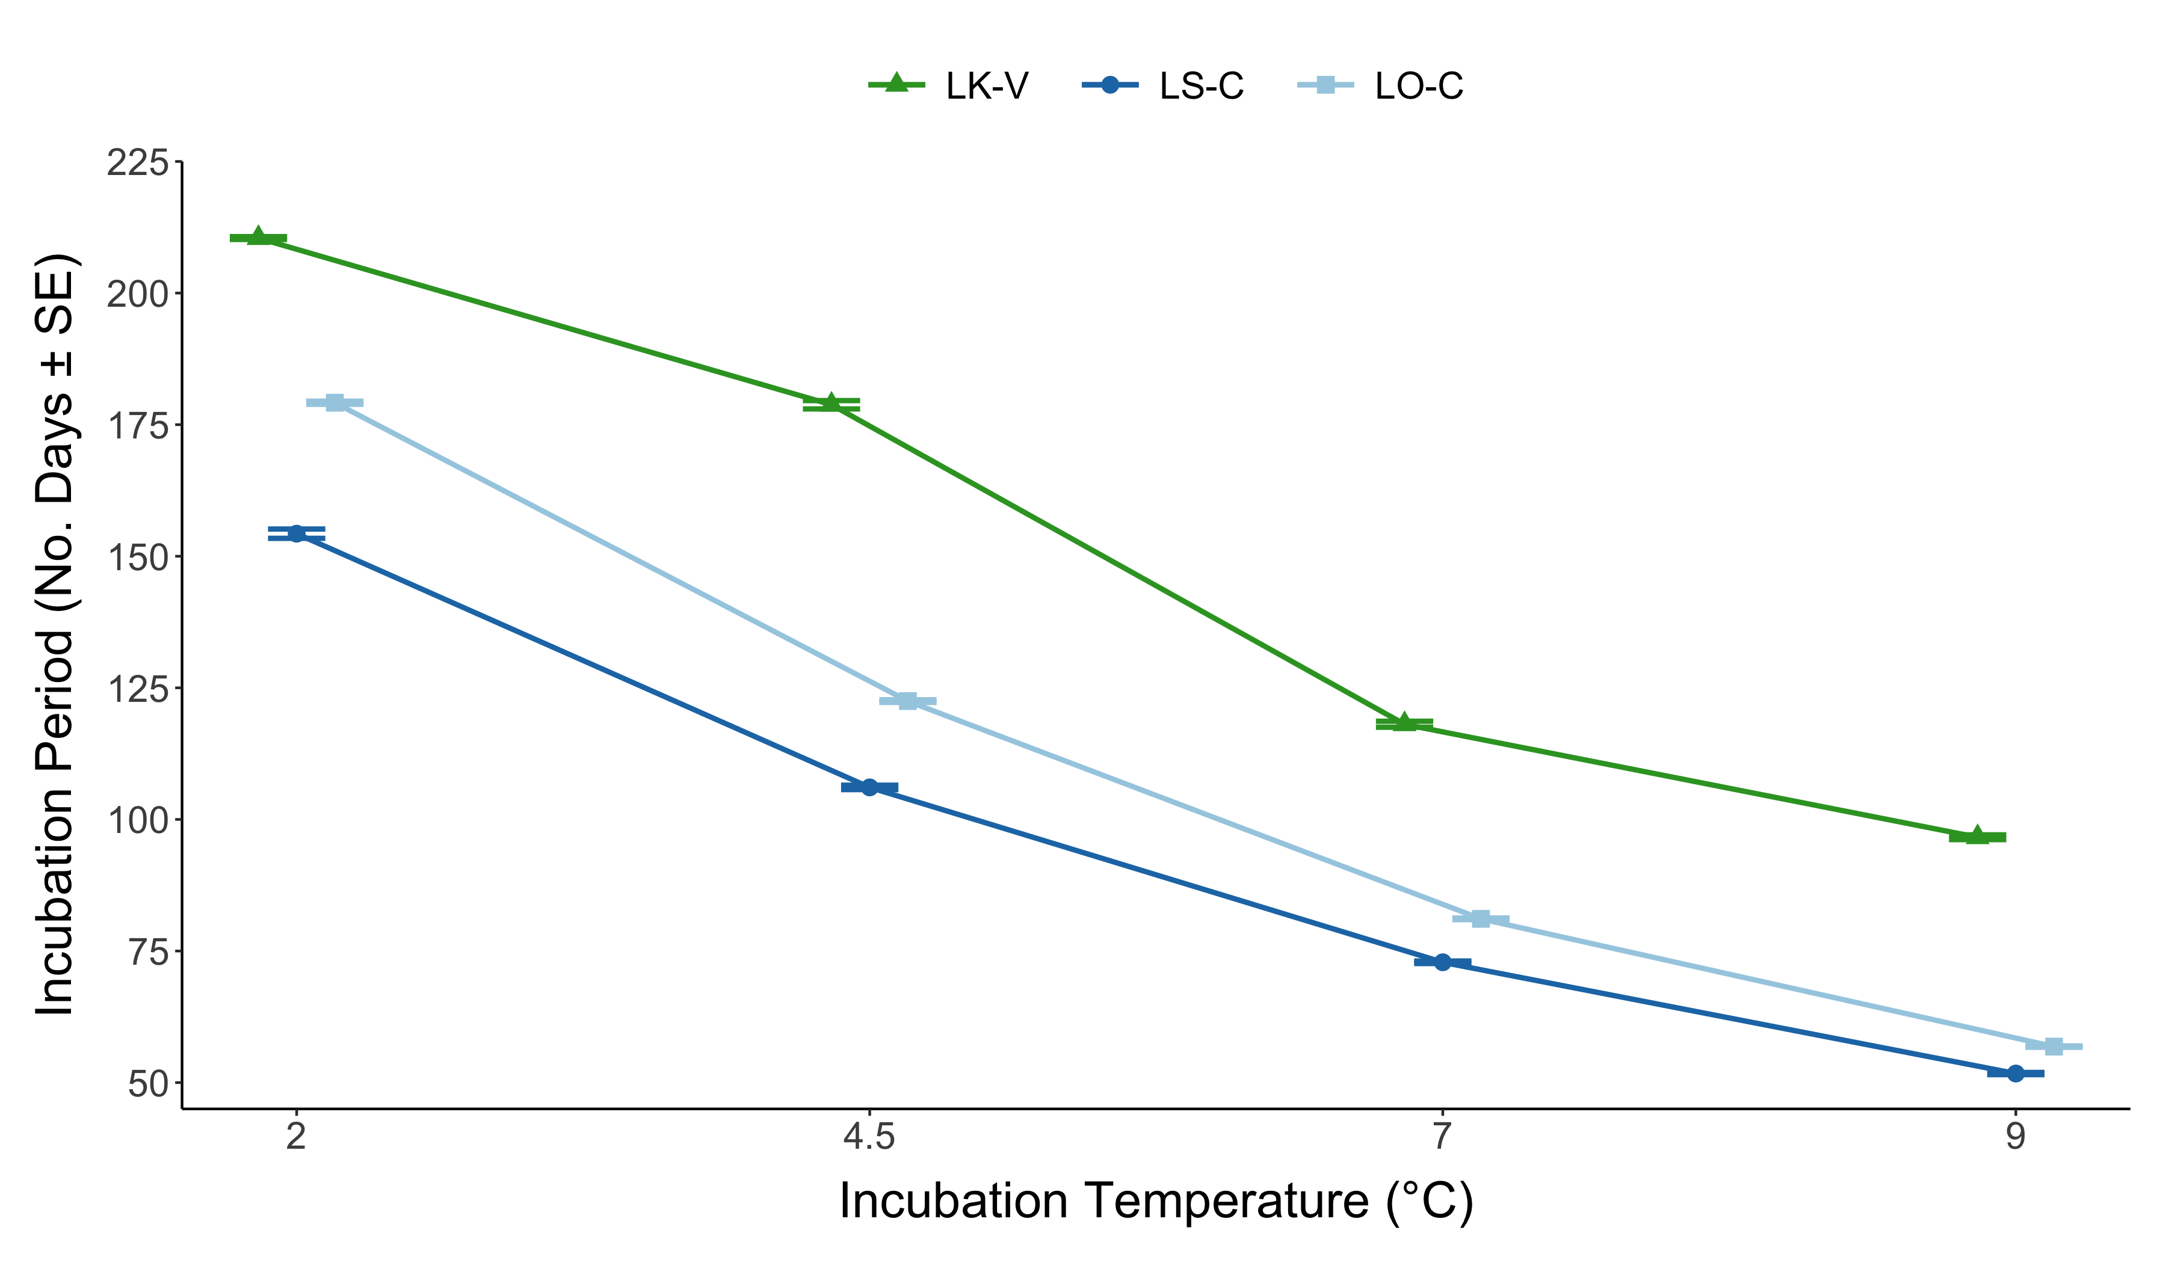

Slide 6
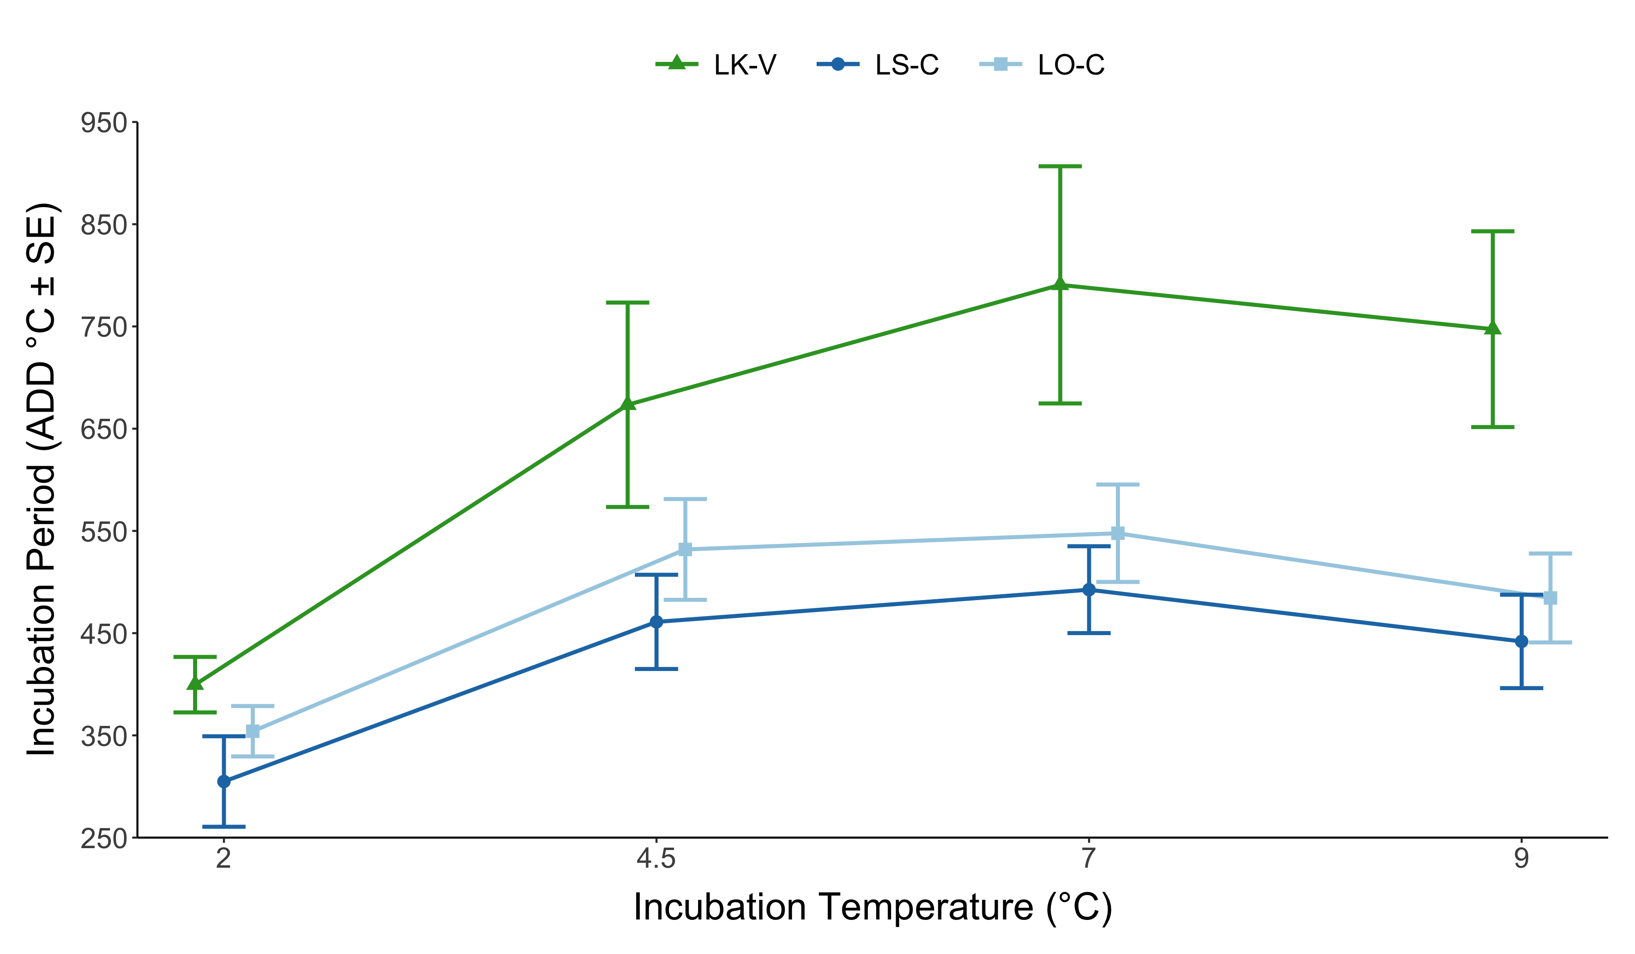

Slide 7
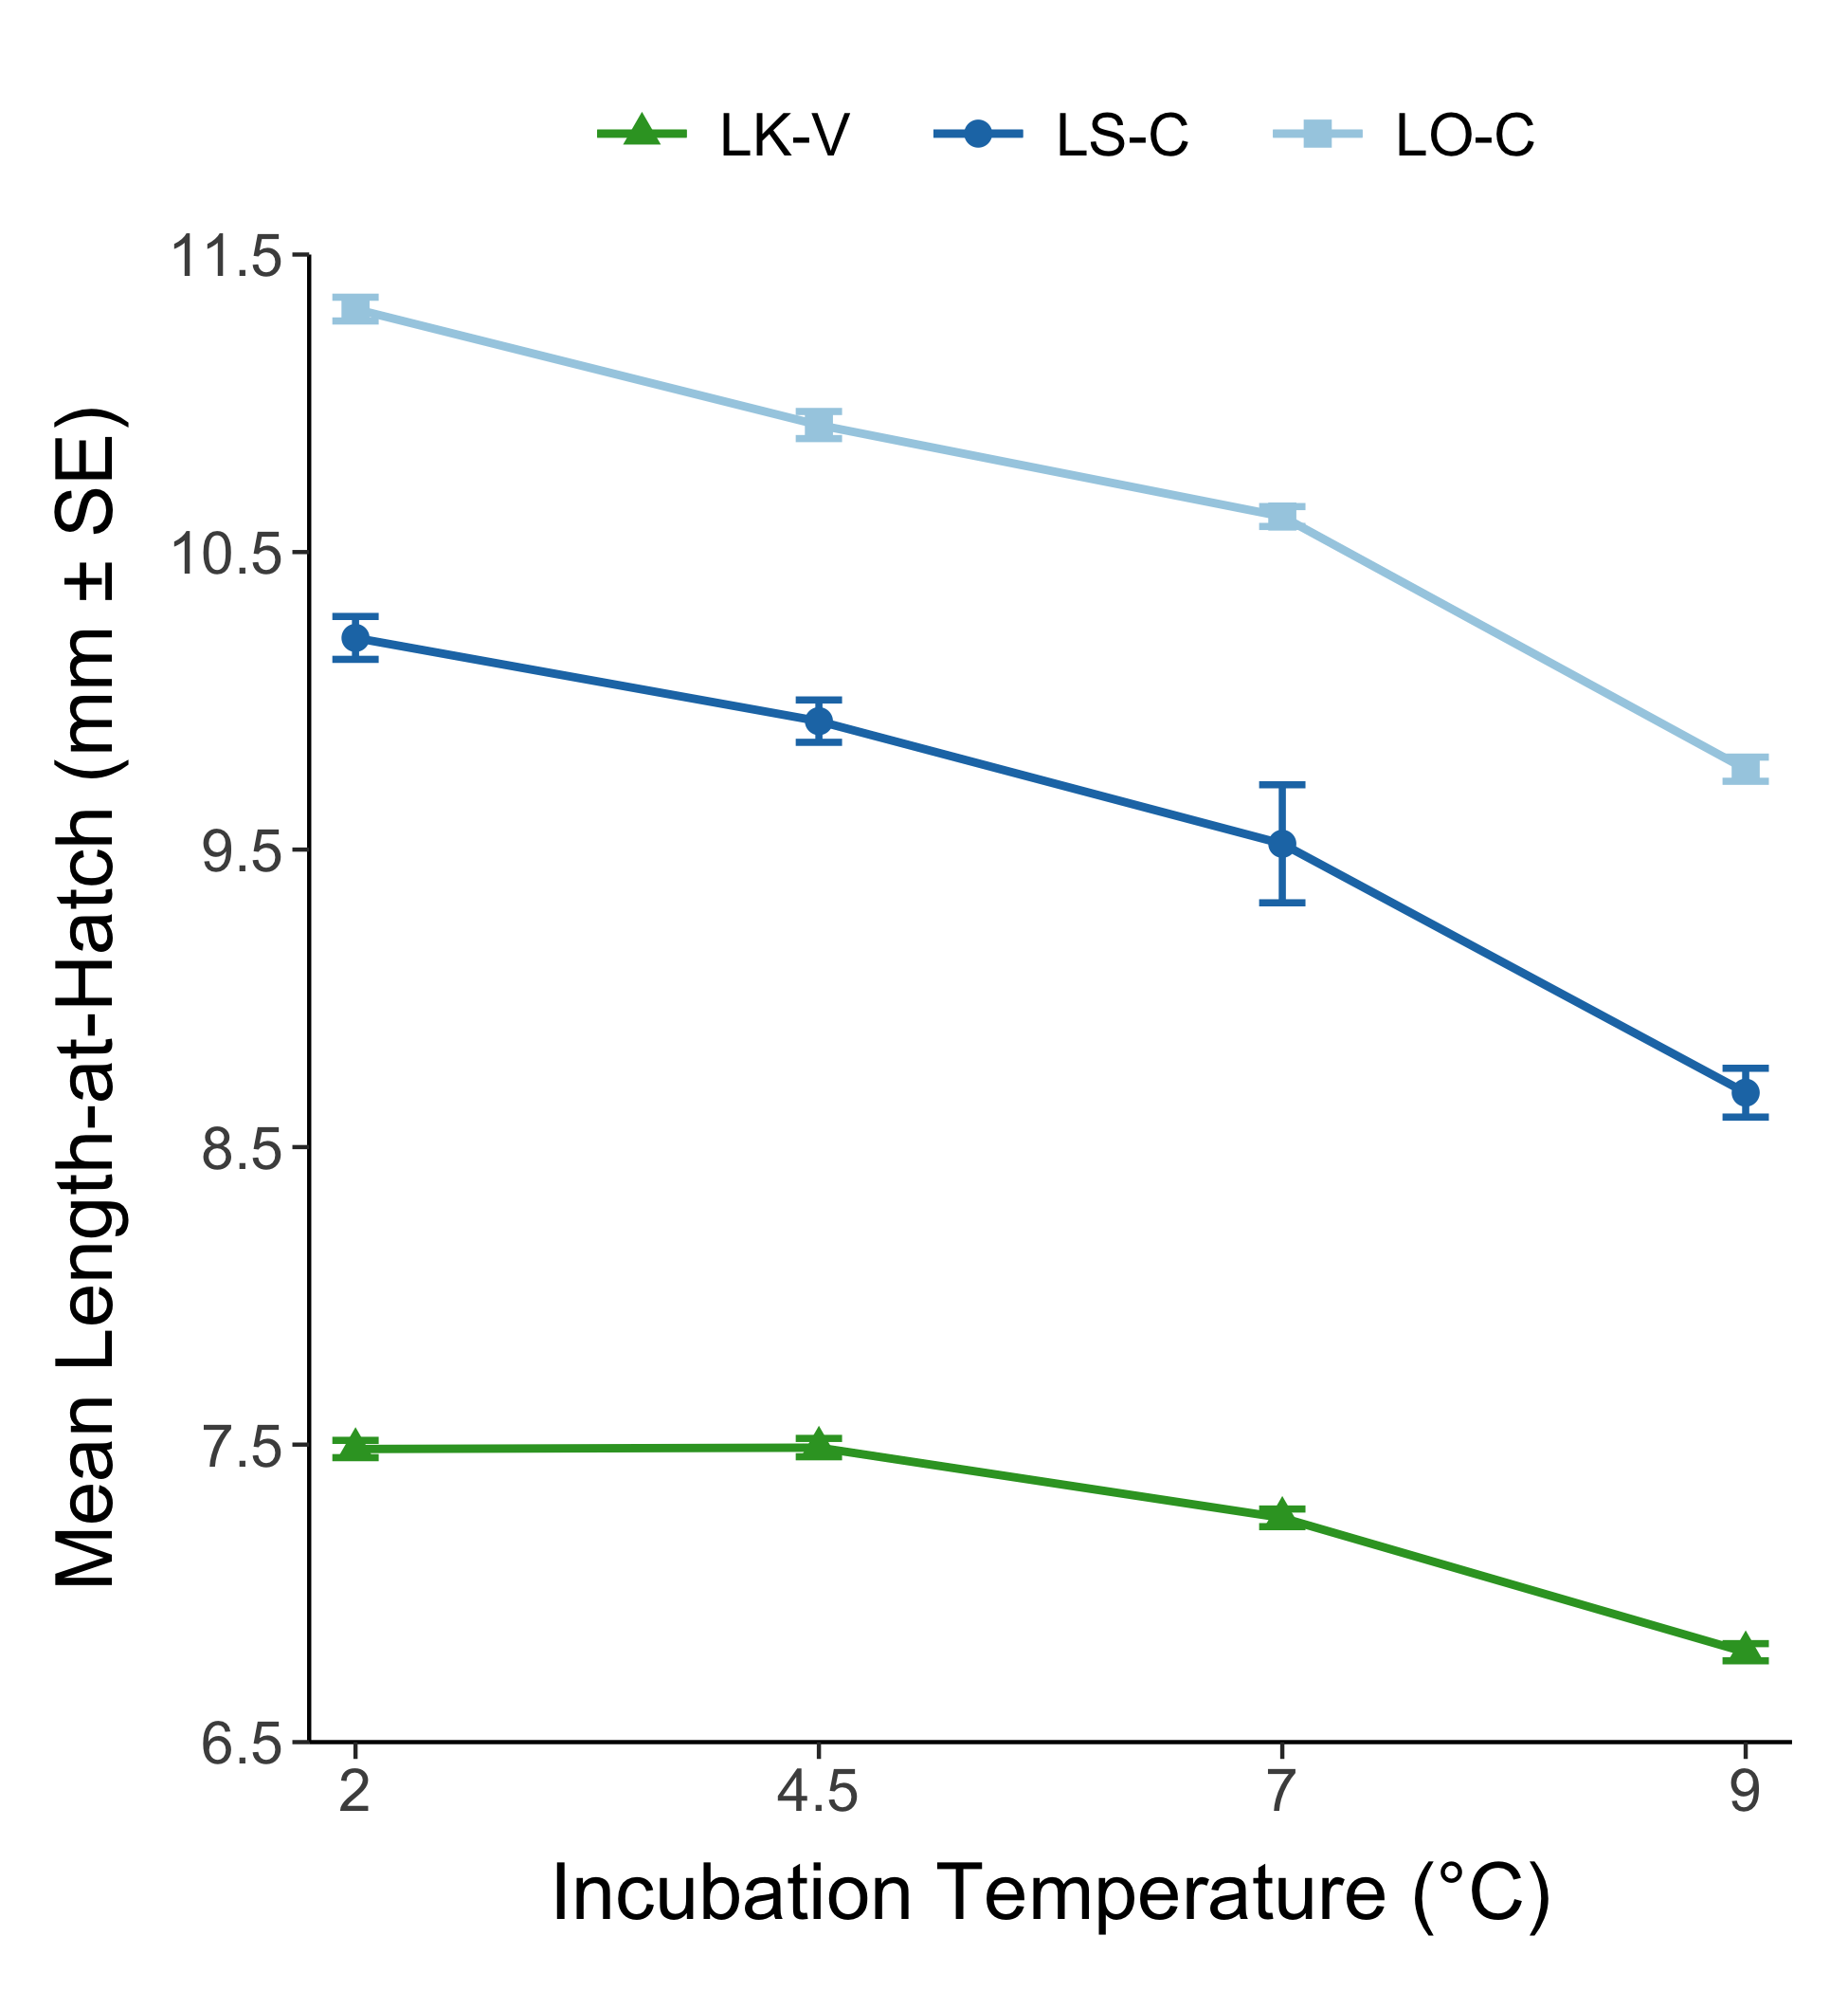
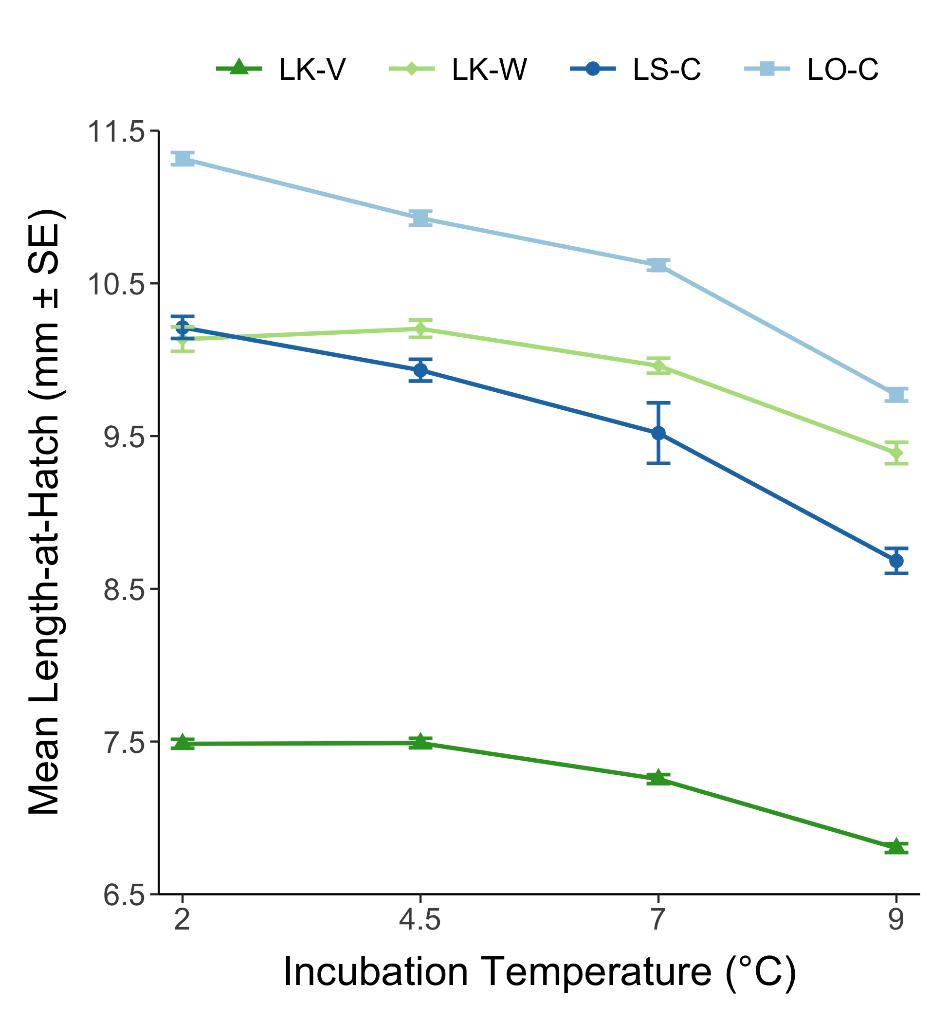
Notes:
Left = no European whitefish, Right = with European whitefish

Slide 8
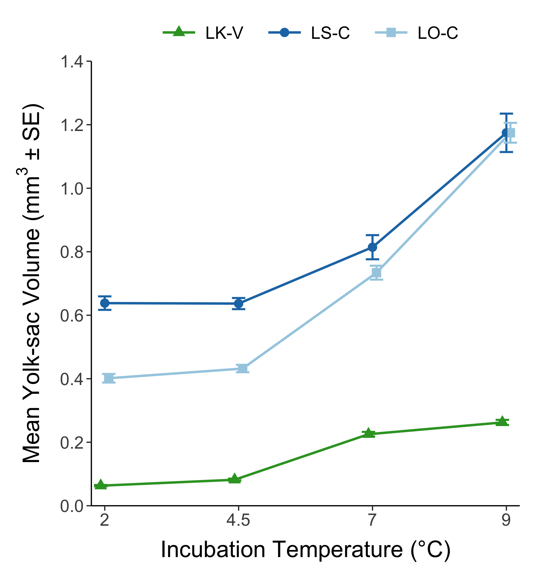
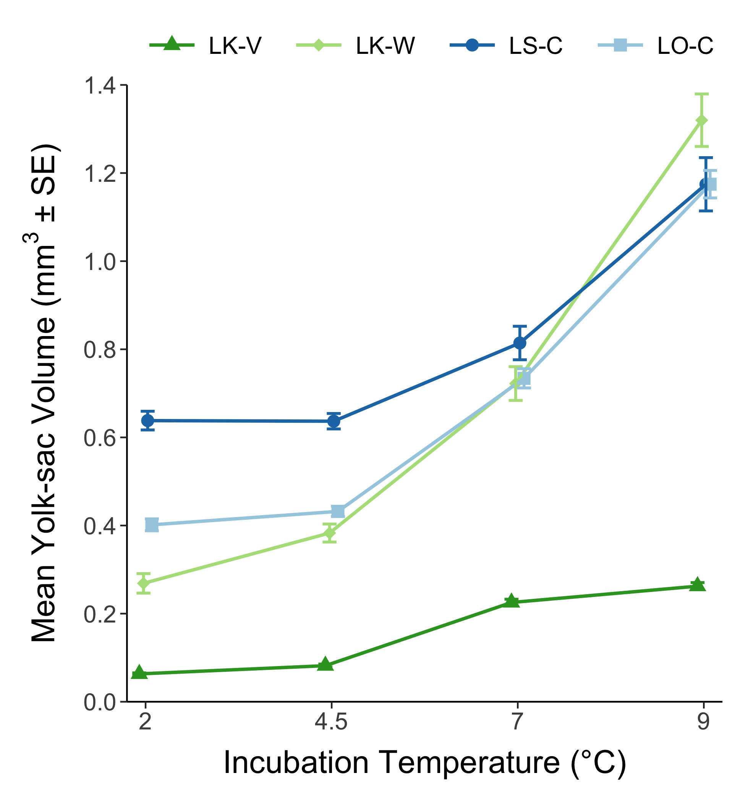
Notes:
Left = no European whitefish, Right = with European whitefish

Slide 9
Notes:
No European whitefish

Slide 10
Notes:
With European whitefish

Slide 11
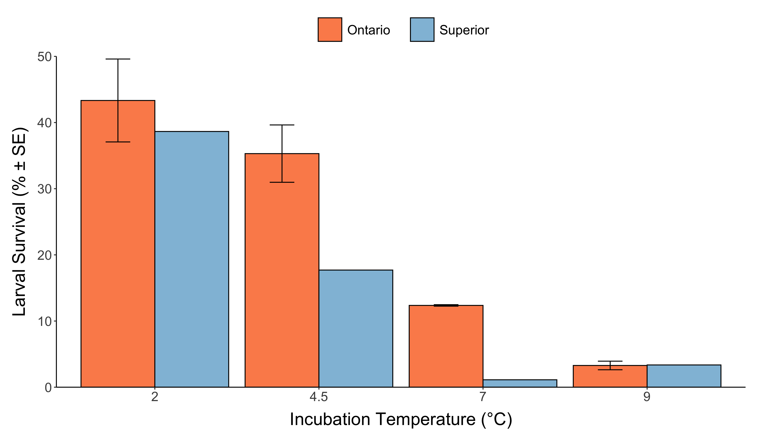
Notes:
Survival after 60 days post hatch
No replicate tank for Superior due to low embryo survival; two replicate tanks for Ontario

Slide 12
Growth

Slide 13
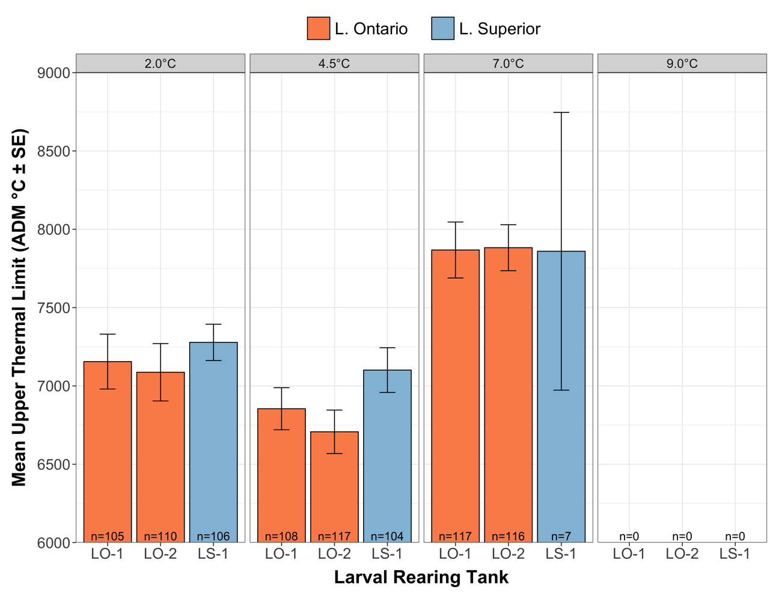
Notes:
winner

Slide 14
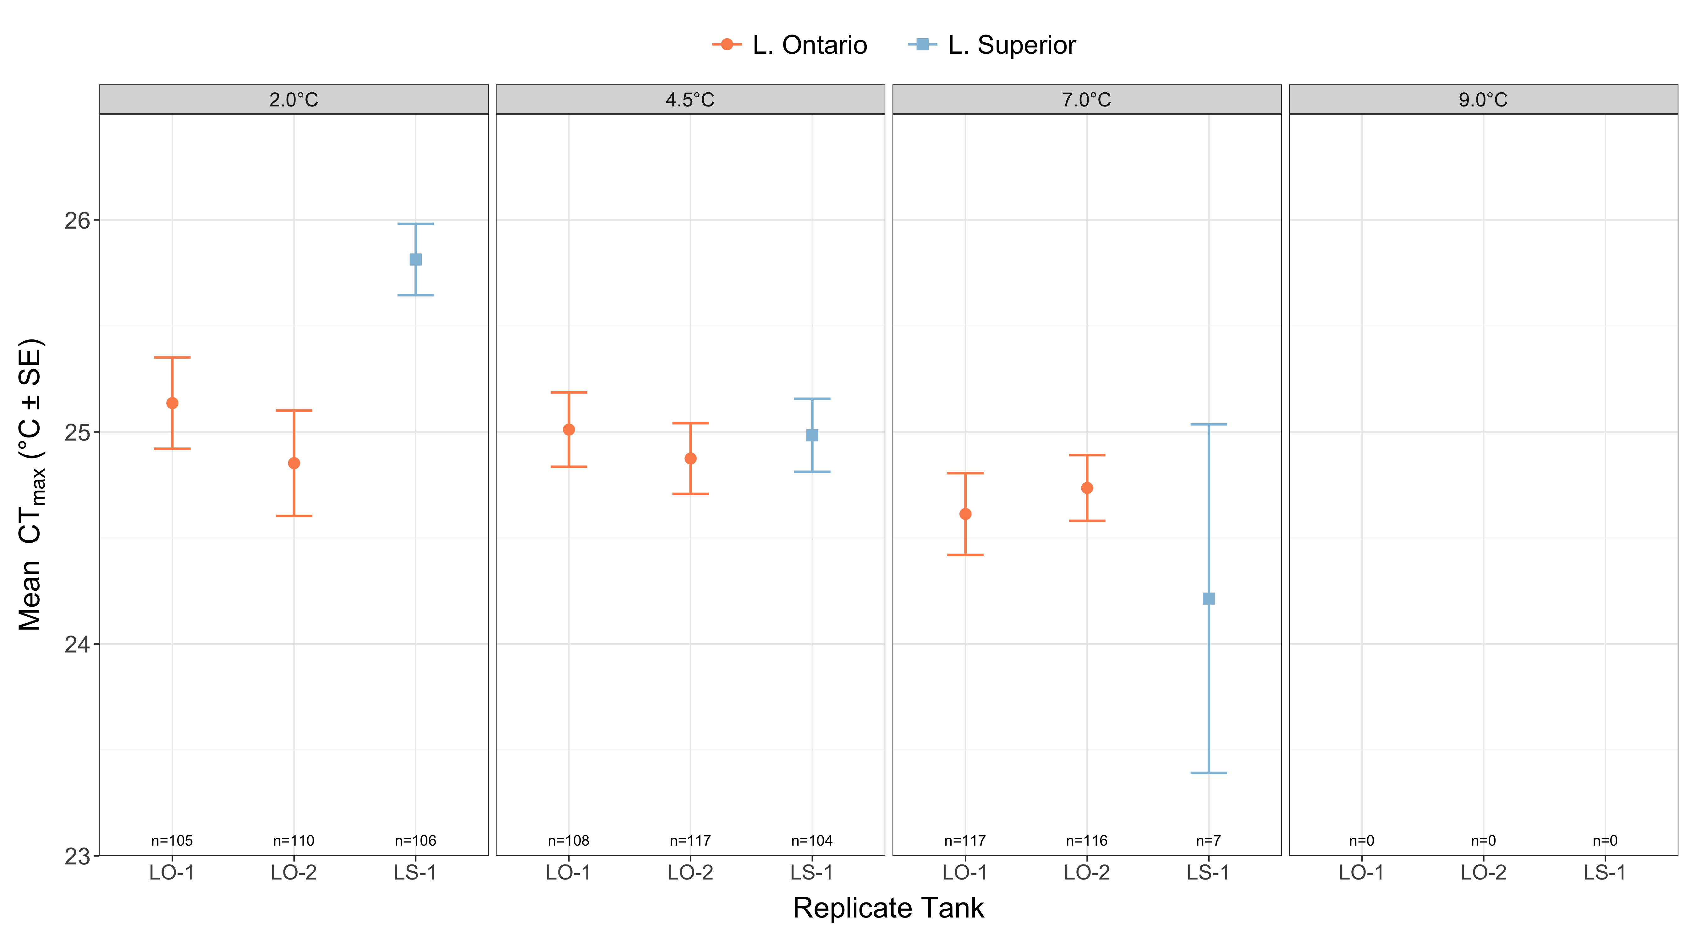

Slide 15
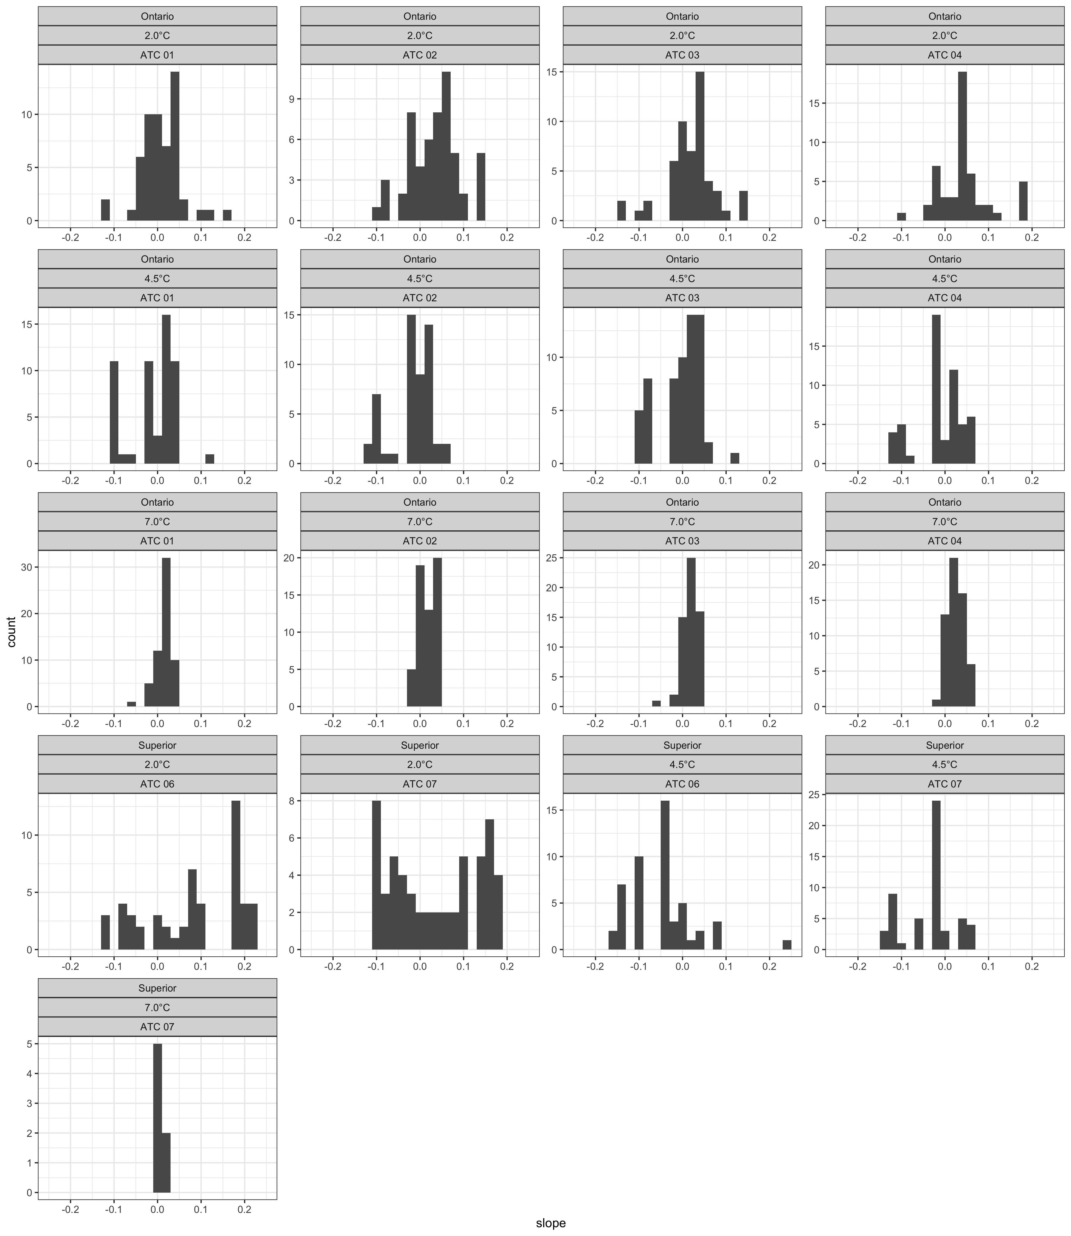

Slide 16
